Slide 1
Deskriptiv statistik

Slide 2
Methodology
Histogram
Measures of position
Measures of variation
Percentiles and Box-plots
Grouped data sets
Confidence intervals
Outliers

Slide 3
1. Methodology
The purpose of a descriptive statistical investigation is clarify a number of characteristics of a given variable measures in time or as a cross section
A descriptive statistical analysis consists of:
Setting up a histogram (or a time series plot) and comment on the shape
Calculating descriptive statistics
Setting up a confidence interval
Setting up a Box-plot and investigating for outliers

Slide 4
What is the Outcome?
The descriptive analysis should provide us with the following answers:
What is the typical
How uncertain is the typical
How symmetric is the data set?
How concentrated is the data set?
Do we observe extreem elements?
Can a well-defined statitical distribution describe the data set?

Slide 5
Histogram
Diskret/kontinueret
Grupperet/Ugrupperet
“praktis” 8-12 columns
What to look for

Slide 6
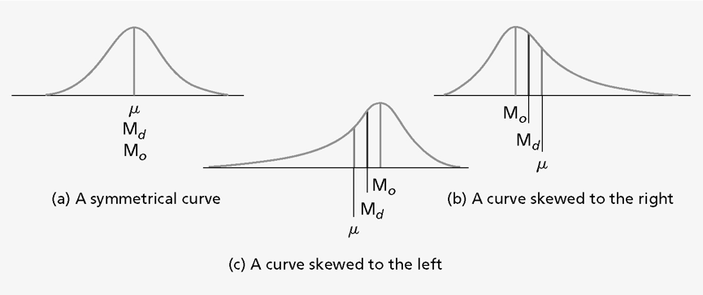
skewness

Slide 7
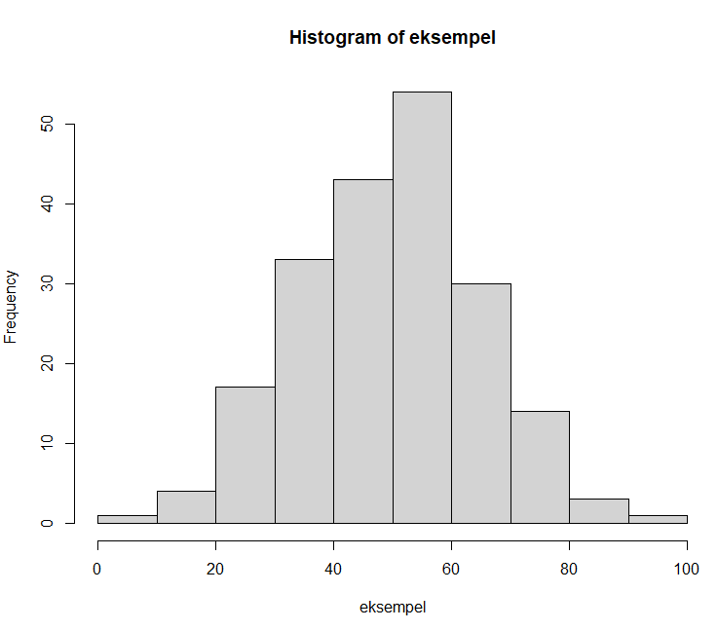

How to in R

Slide 8
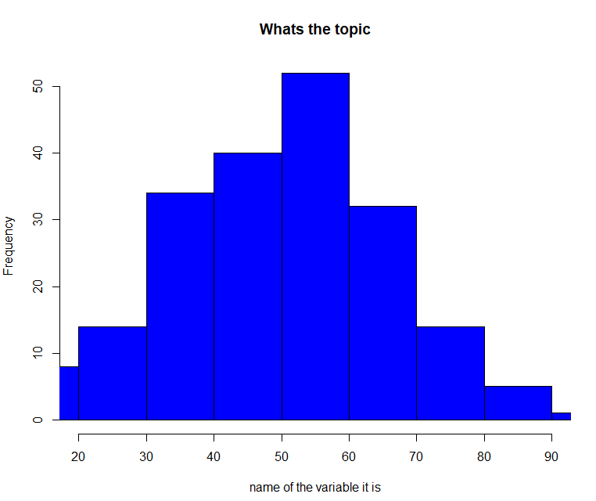
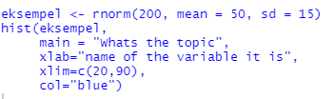

Slide 9
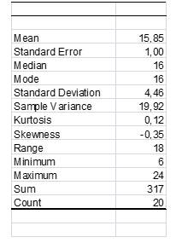
Normaly we look at following

Slide 10
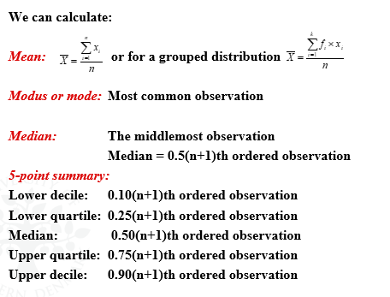

Slide 11
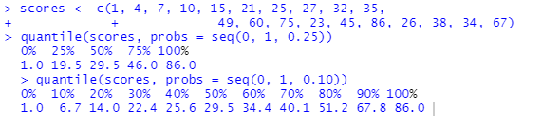

Slide 12
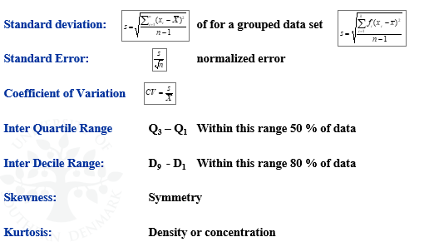
How to find:

Slide 13
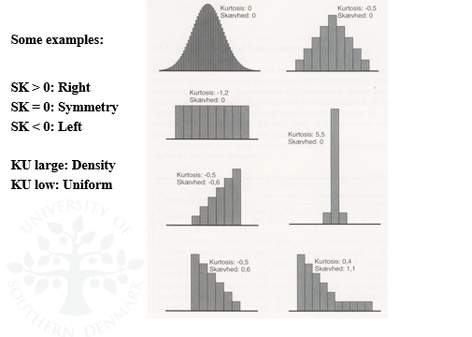
Skewness and kurtosis

Slide 14
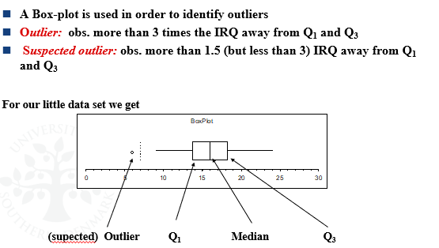
Box-plots

Slide 15
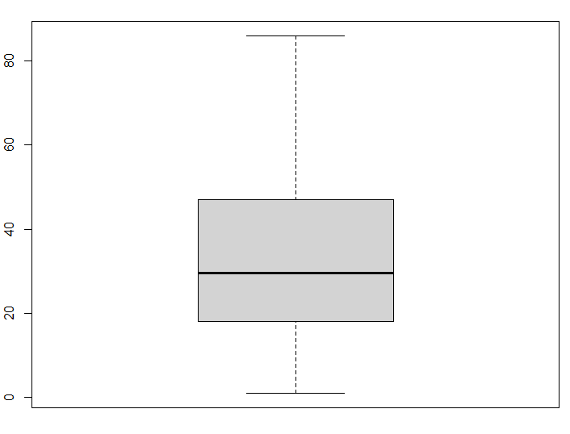
IN R
boxplot(scores)

Slide 16
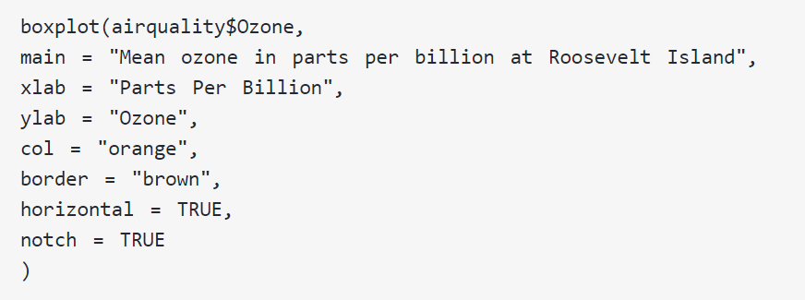
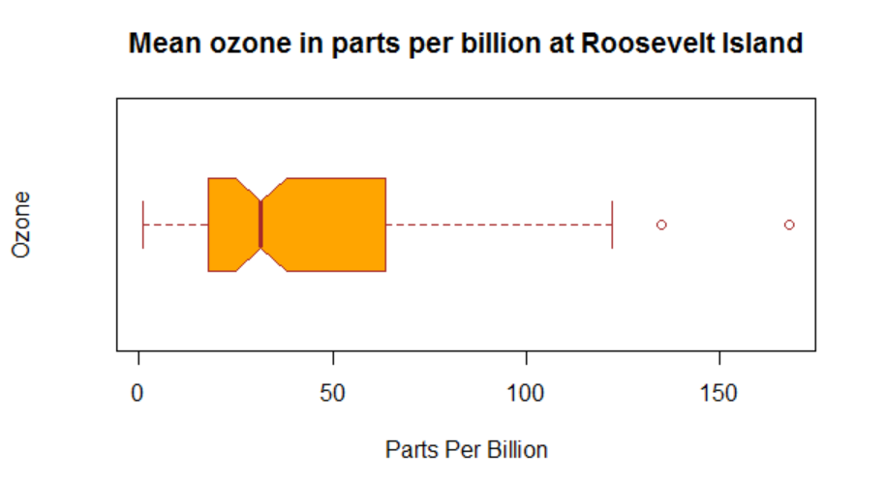
More fancy version

